Slide 1
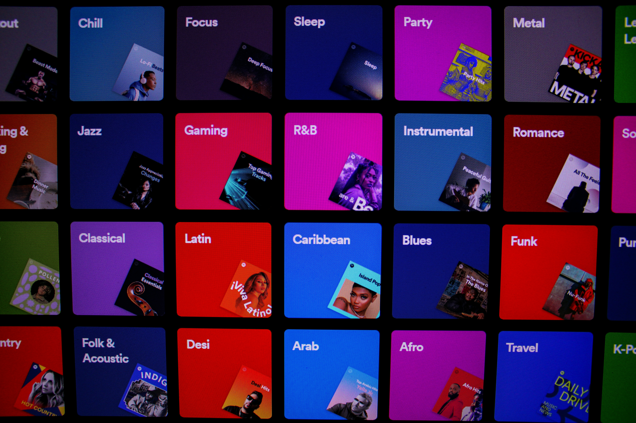


Slide 2
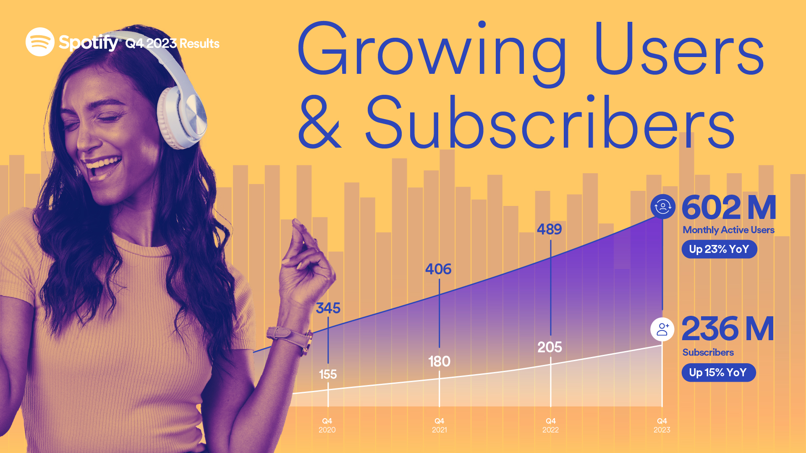

Slide 3
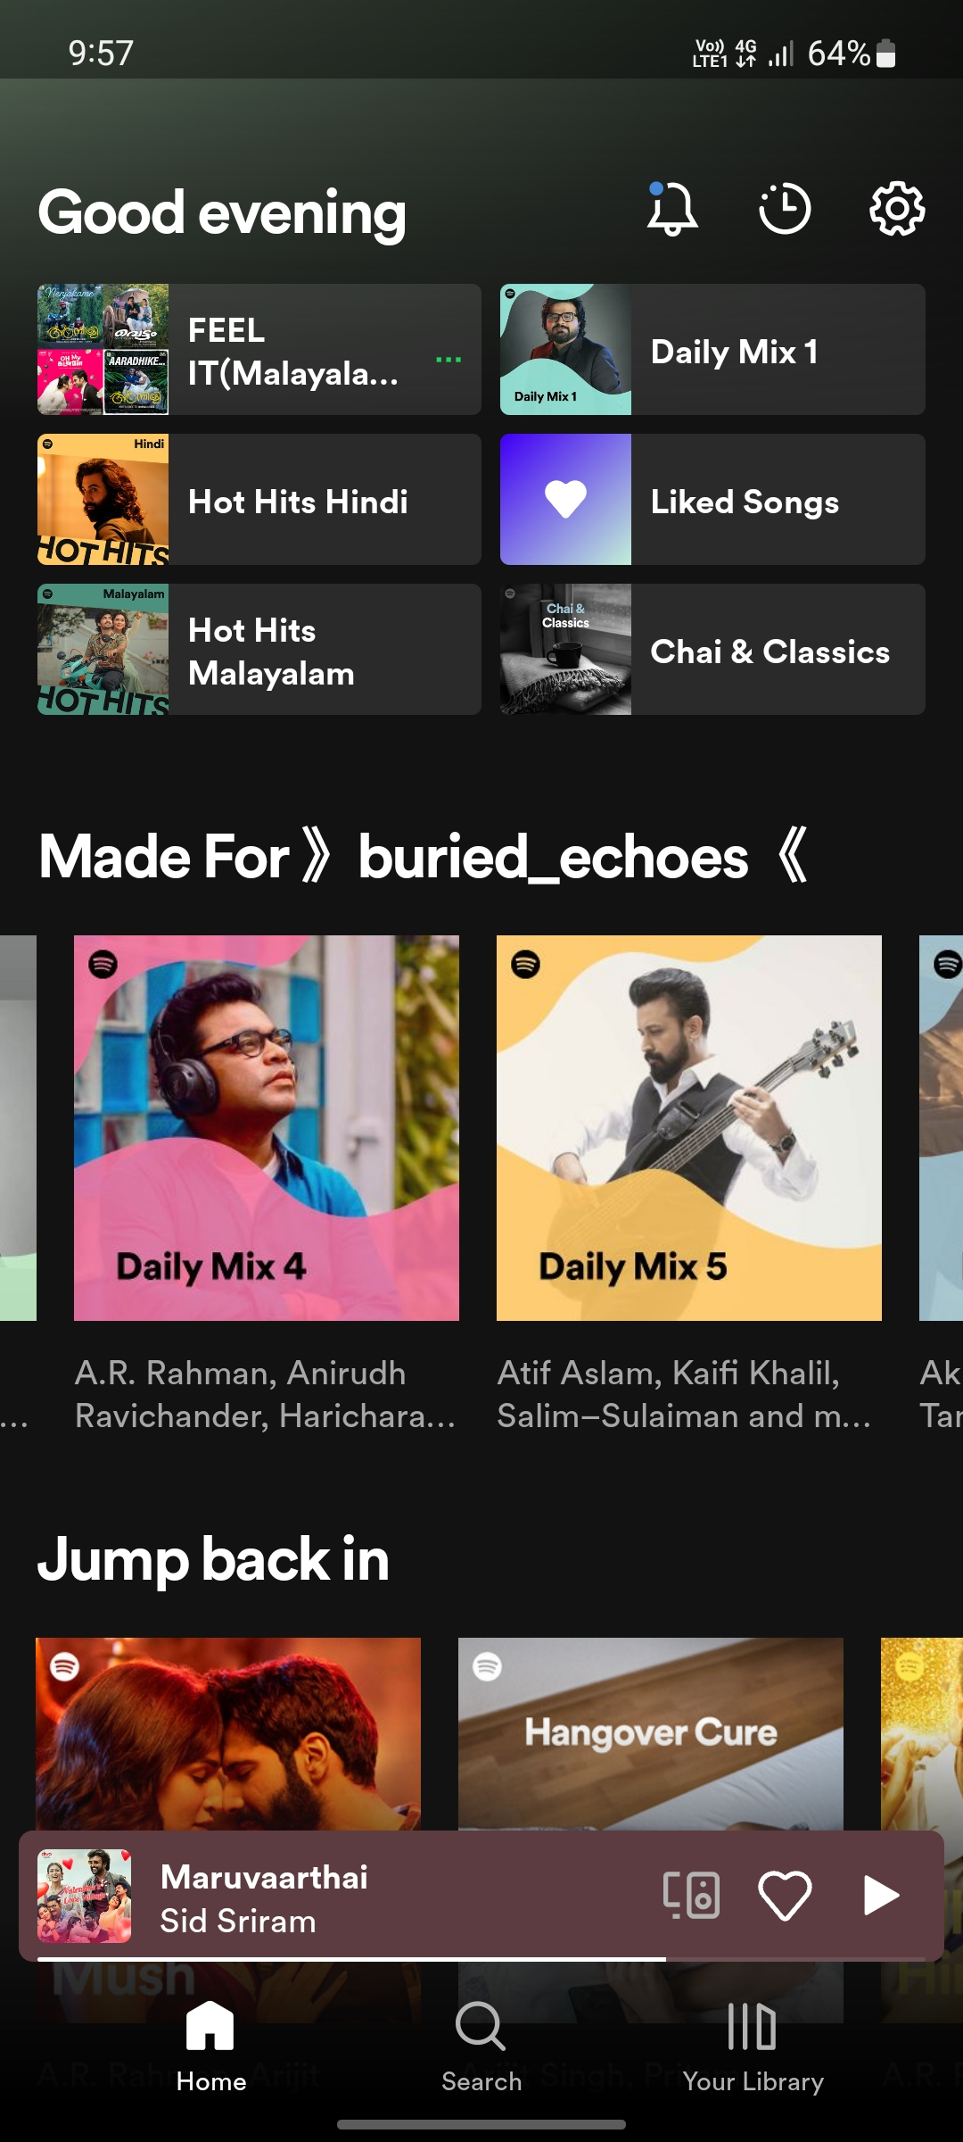
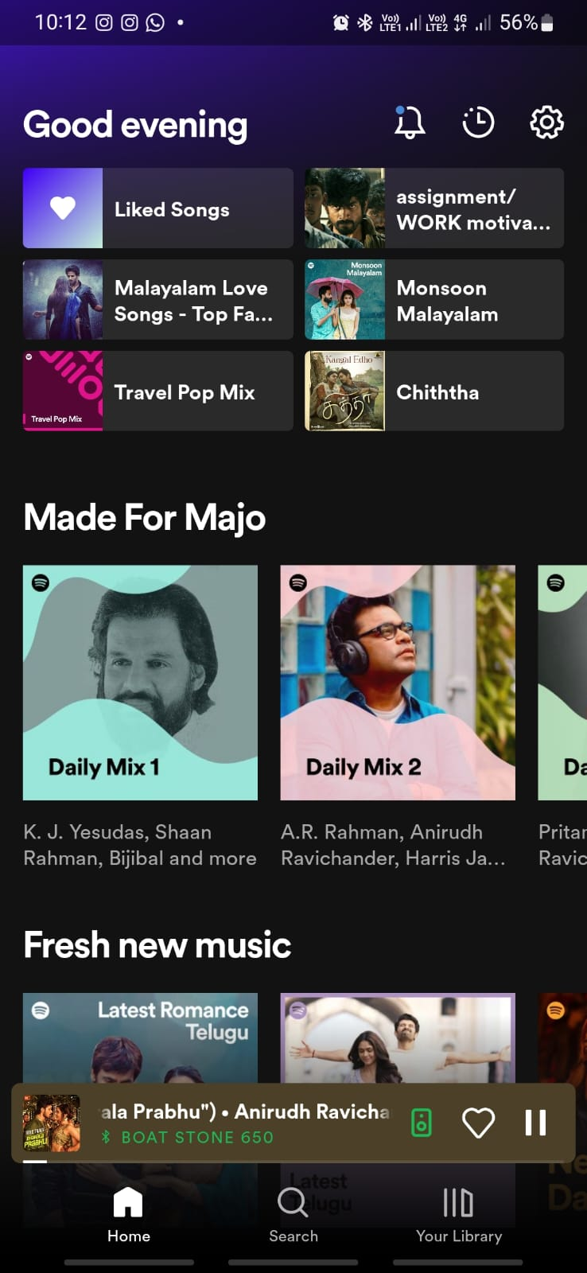
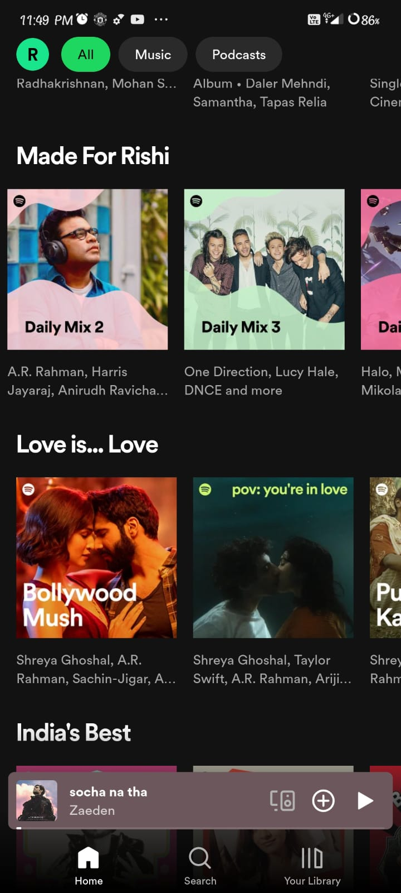

Slide 4
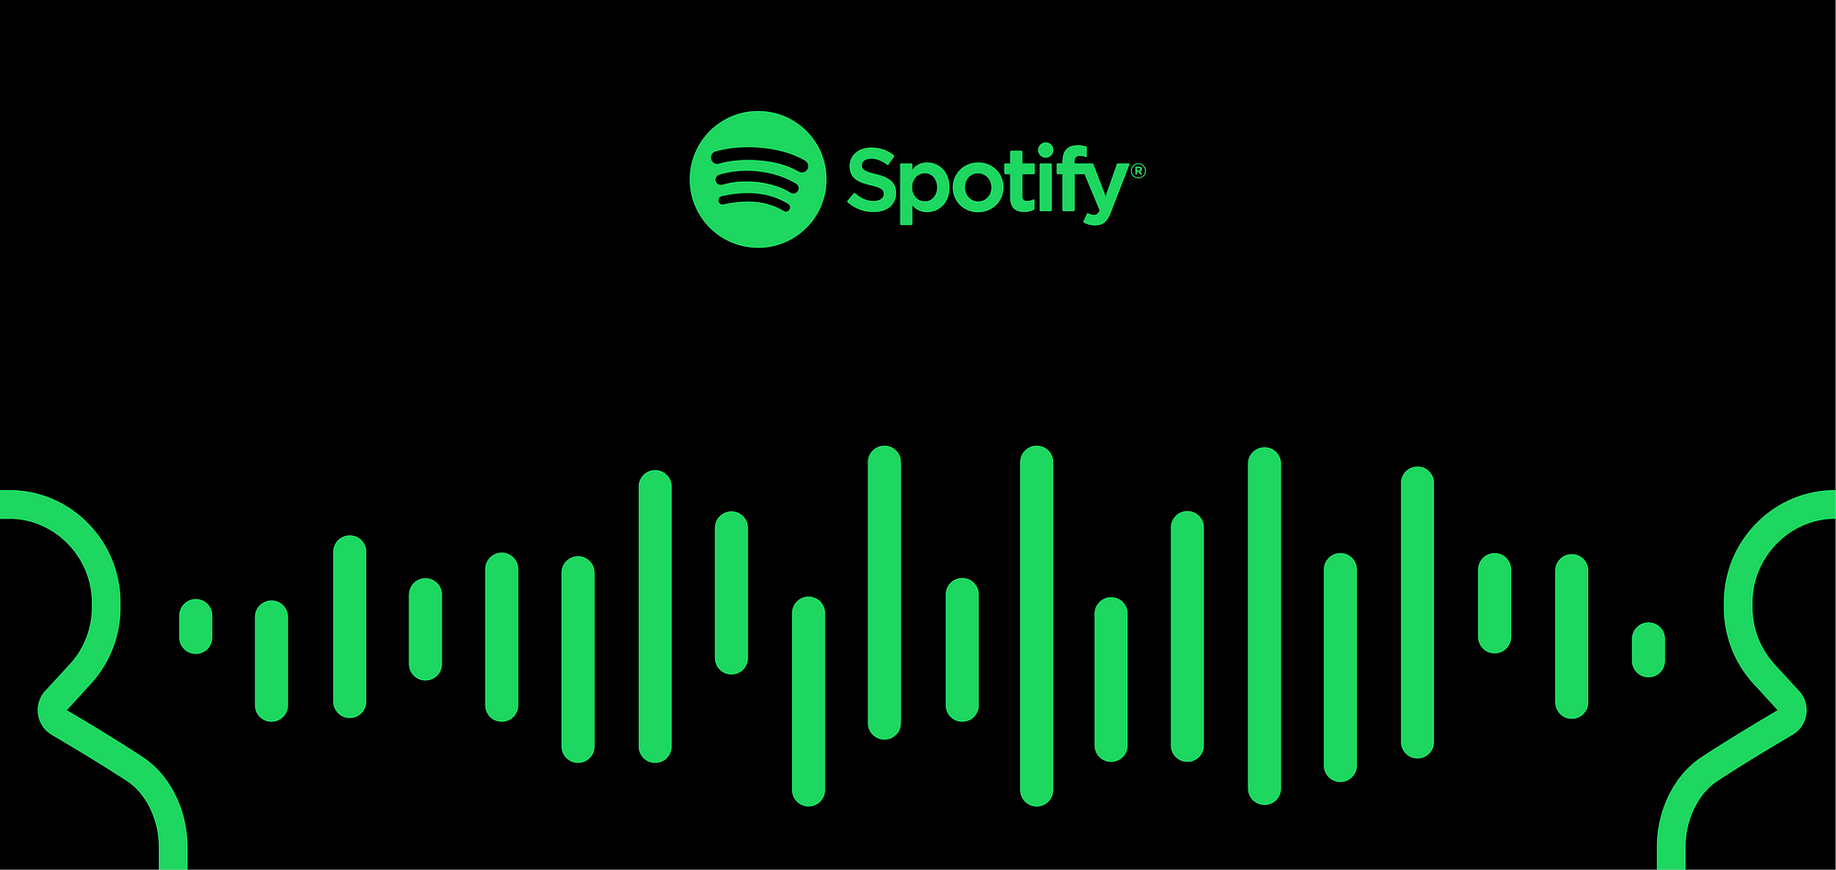
BaRT

Slide 5
Bandits for Recommendations
as Treatments

Slide 6
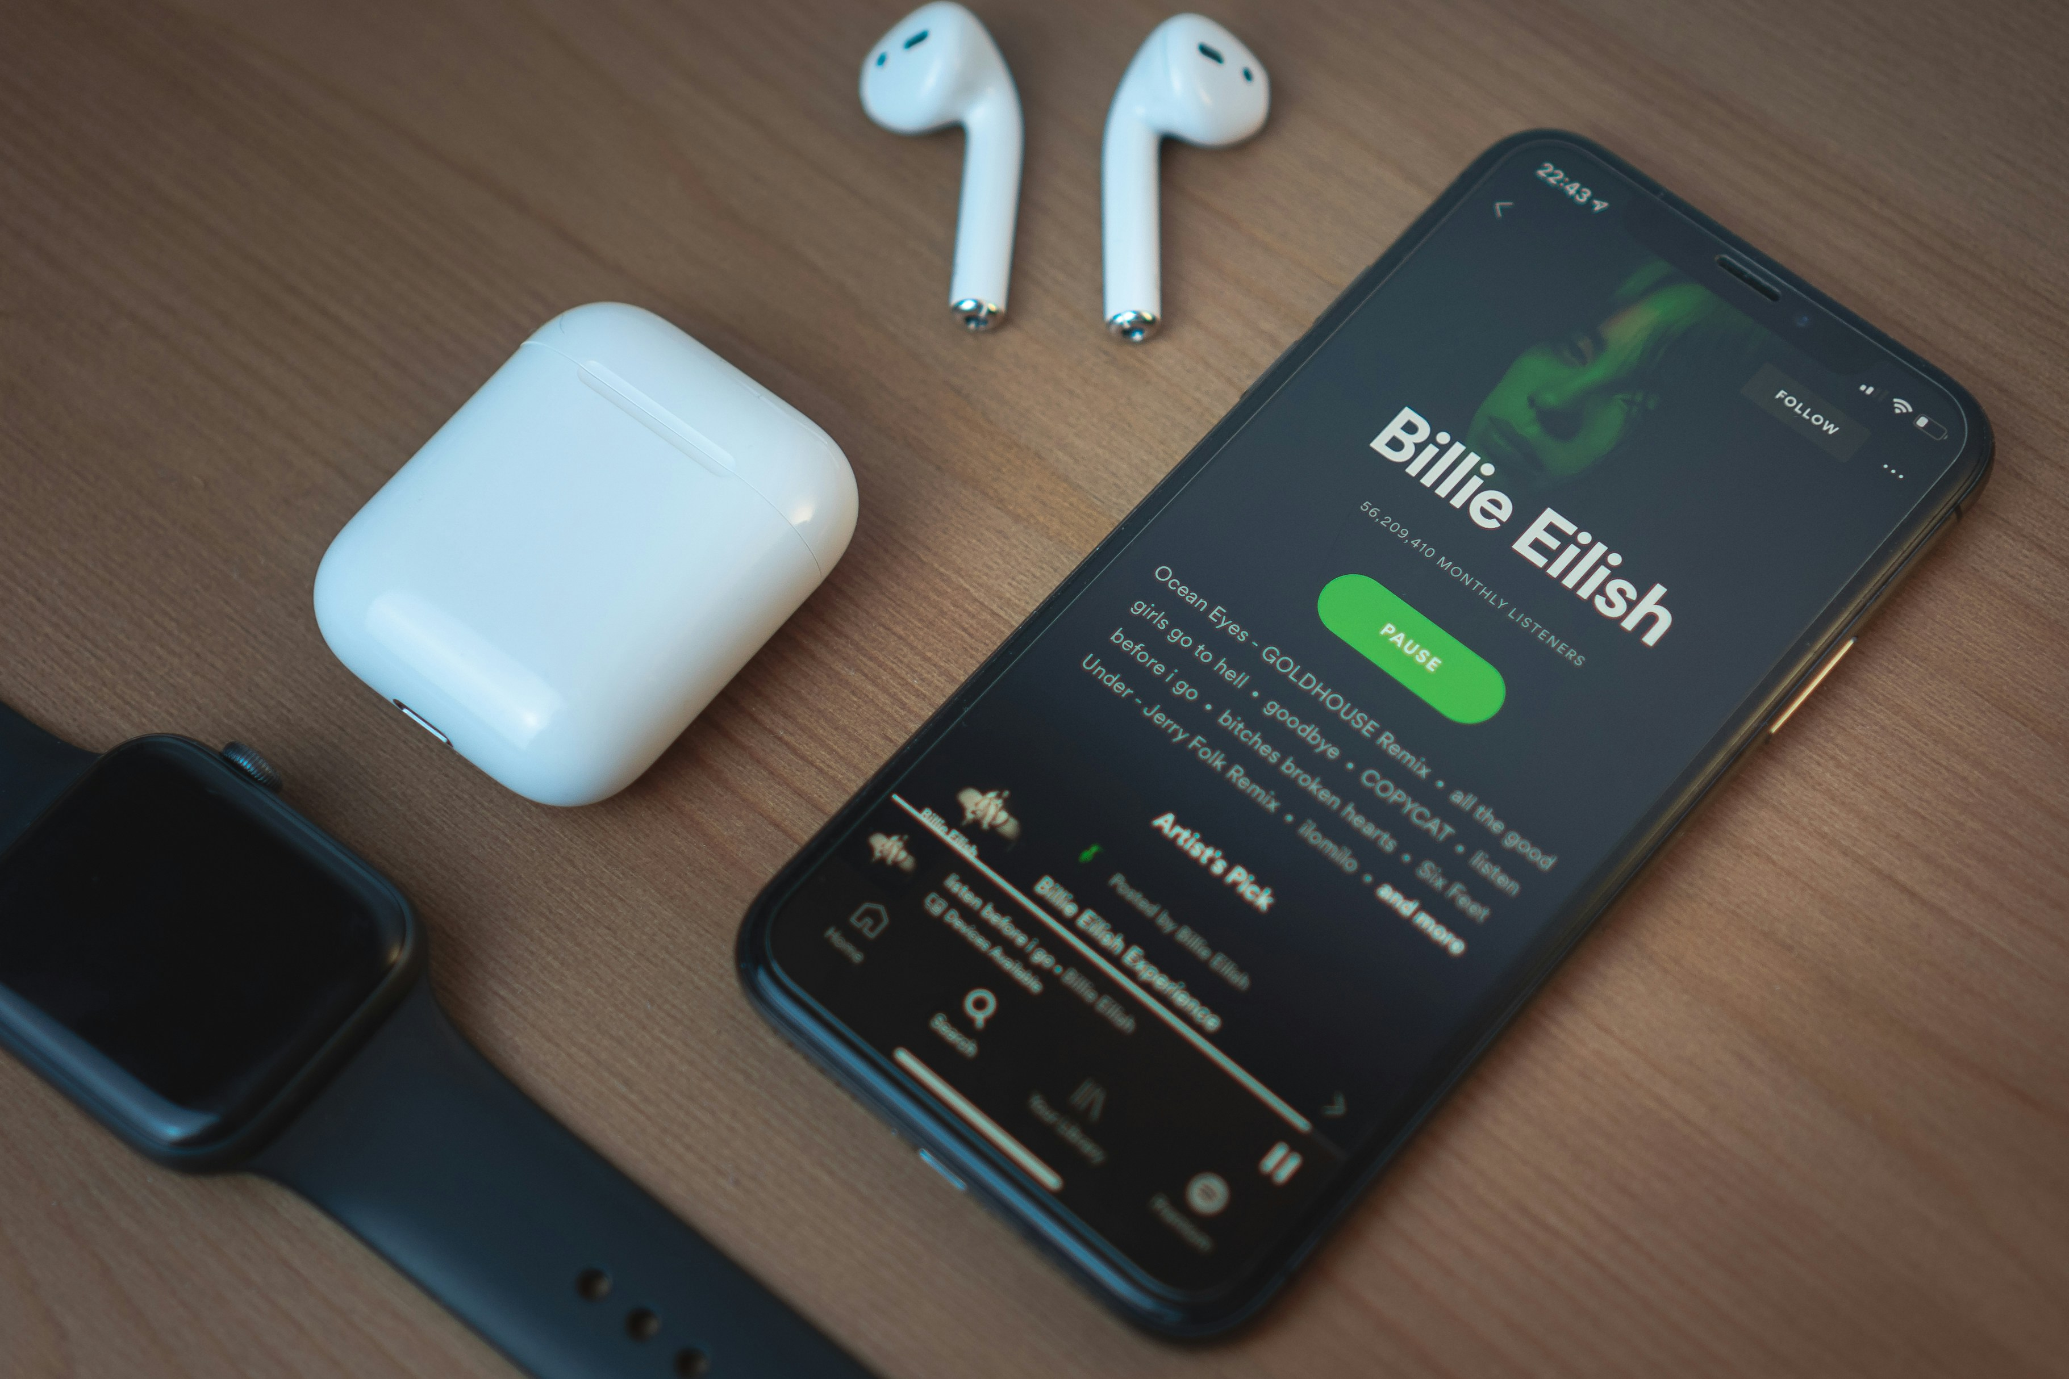
How BaRT Work ?
Natural Language Processing
Raw Audio Analyzation
Collaborative Filtering

Slide 7
EXPLOIT & EXPLORE

Slide 8
EXPLOIT & EXPLORE
Analyzing your behavior
Analyzing others (artists/ users)
Analyzing Audio
Your playlists
Your skipping behavior
Your favorite artists/songs
What you have shared
How often you listened to a playlist or a song
Your favorite genre
When you listen and
Playlists of others
What is trending
What do people similar to you also like and listen
Which artists are similar to your favorite artists
What new songs of your artists are out
Analyzing spectrograms of songs
mode of a song
key of a song
tempo of a song
loudness of a song
amplitude etc.
Collaborative Filtering - Exploit
Collaborative Filtering - Explore
Content-based Filtering via CNN

Slide 9
THE 30’S RULE

Slide 10



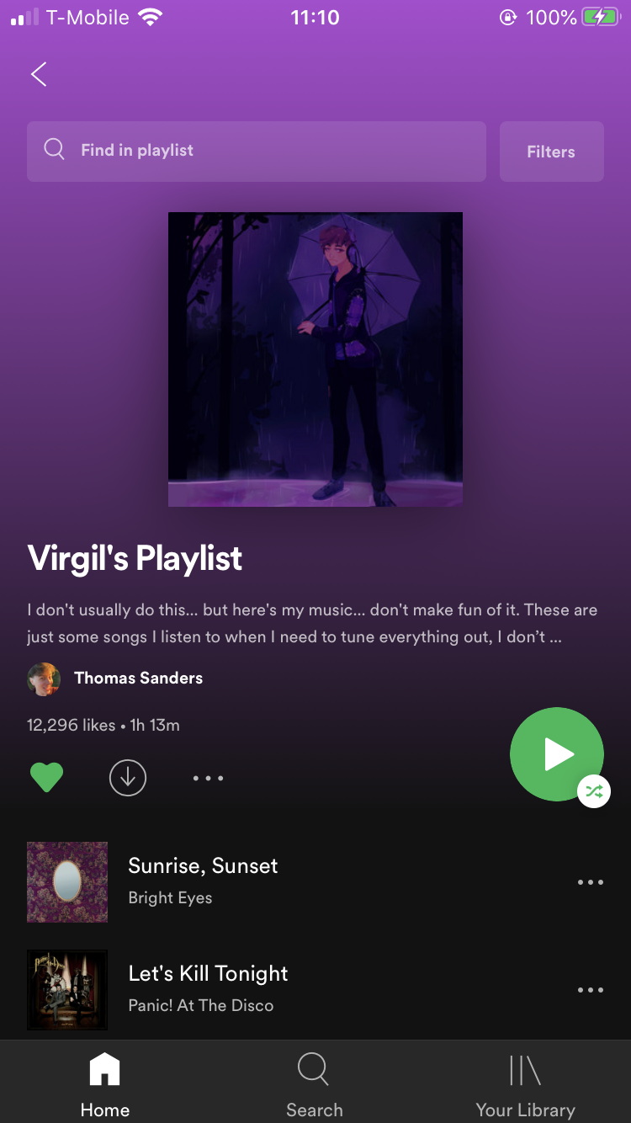
Metadata
Play Logs
A NEW SUGGESTION
Starboy
2023 • Album
Blinding Lights
2023 • Album
...
...
A User Similar To
ME
Songs Skipped
Playlists you’ve made
listening history

Slide 11
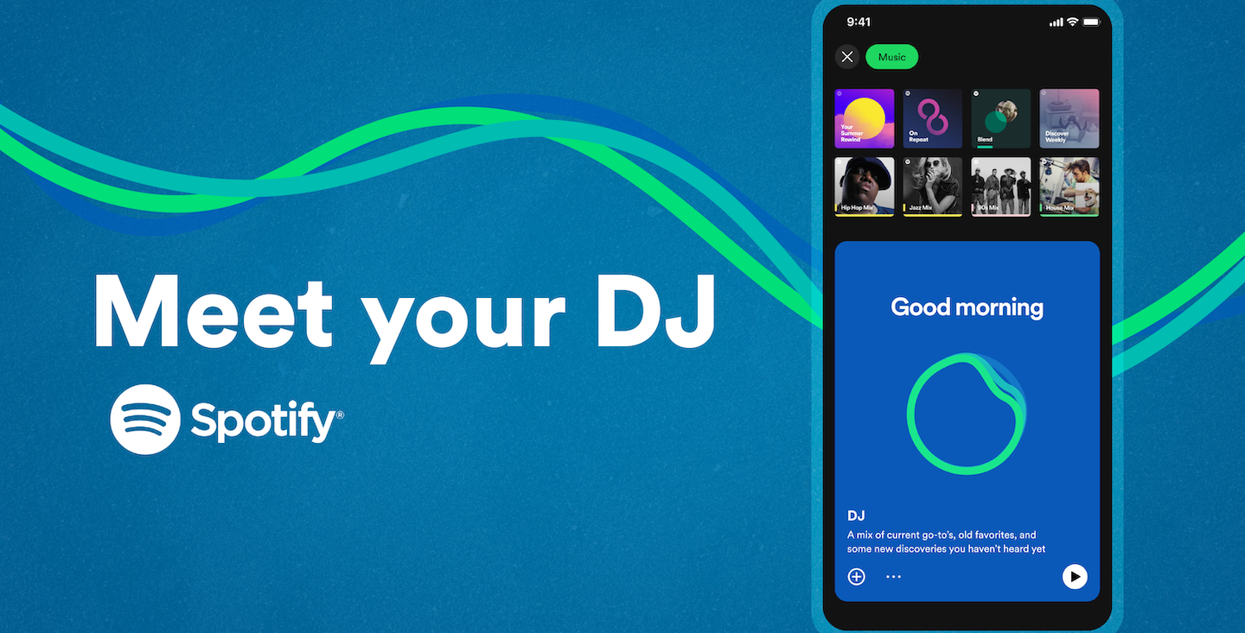

Slide 12
Thank You

